Slide 1
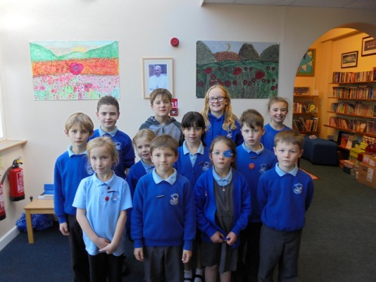
Junior Leadership Team

Slide 2
Notes of meeting from 20.11.15
Present all Junior and Senior Leadership Teams
All year groups talked about anti-bullying week and the impact it had on them and their peers.
Initially in classes, children learnt about what bullying was and the impact it has on other children. Classes did a number of different activities. All classes said the week had a very positive impact on each other and noted that it had affected behaviour in the playground in a positive way.
The JLT requested another week possibly in the summer to ensure the messages learnt this week are not forgotten. LB to action
Then Mrs Buchanan showed the JLT the new website and asked the JLT if it was easy to navigate and their initial thoughts. The JLT felt it was much more user friendly but Harriet asked if Mrs Buchanan could check to ensure it is tablet and smartphone assessable as at the present the existing website need a flash drive. LB to action
Children also noticed that the photos used in the prospectus were over 2 years old and asked if these could be updated. LB and Governors
AOB- Benji asked if German could be taught in school. Unfortunately at present there is no member of staff who speaks German, so not feasible.
Meeting finished at 12.45

