Slide 1
Holy Trinity Catholic School Headteacher’s Report to Governors Autumn 2015

Slide 2
The Leadership and management of the school

Slide 3
Staffing
Staff
Year 4 and the new NQT teachers have settled very quickly into the life of HT. Both staff have attended induction meetings with the Head.
The NQT teacher has attended a number of NQT courses and has had a number of meetings with her mentor (NJ).
All staff have had generalist safeguard training as well as prevent training.
We have welcomed a new addition to the team- Mrs Percy gave birth to her second child in October ‘Ted’. Congratulations to her and her husband.

Slide 4
School Numbers
Number on roll | FS2 | Year 1 | Year 2 | Year 3 | Year 4 | Year 5 | Year 6
 | 30 | 29 | 25 | 30 | 31 | 25 | 26
No of Catholics | 7 | 12 | 6 | 10 | 7 | 10 | 3
Basic characteristics of the school
Characteristics | National | School | Comparison
Number on roll | 269 | 196 | below
%free school meals | 26 | 8.5 | low
%pupils from minority ethnic groups | 30.7 | 7.7 | Very low
%EAL | 19.5 | 3 | Very low
Deprivation indicator | 0.24 | 0.10 | low
Average point score in Year 6 in 2015 | 28.8 | 31.2 | Above average
Pupils with SEN support | 13 | 12.5 | Average

Slide 5
Pupil Premium expenditure Total allocated for 2014-2015 £19,500
Focus on Learning in the curriculum 28%
Focus on social, emotional and behaviour 26%
Focus on enrichment beyond the curriculum 15%
Focus on early intervention: 31%
Action
Allocation |  | Desired Impact / Outcome
TA small group /individual support 3 days each week | £3,870 | Emotional and social well-being of targeted pupils. Increase in pupil confidence and self esteem. To improve pupils’ achievement
2 x Additional teacher ½ day | £4,950 | To improve pupil achievement by accelerating progress
Purchase of ICT equipment | £1,500 | To improve pupils’ achievement, motivate reluctant readers to writers
Teacher one to one support | £1,050 | Improved results Pupil progress meetings 3 x annually
Resources: KS1 reading support scheme Sent up of reading volunteer group/area KS2 Guided reading scheme Maths (models and images) | £2,500 £500 £1,370 £1,000 | To improve pupils’ achievement, motivate reluctant readers to read To help children develop a sense of number order and number pattern
Financial support for Residential Trip and curriculum enhancement days | £560 | Pupil and parental feedback
Theatre Bursary | £900 | Pupil Feedback
Contribution Educational Psychologist | £750 | Expertise and help to meet the needs of children
Continuing Professional Development: including Inclusive Strategies training | £600 | More effective planning and teaching to meet the needs of all children
Total | £19,500

Slide 6
Impact of Pupil Premium Funding

Slide 7
Pupil Premium expenditure Total allocated for 2015-2016 £22,100
Focus on Learning in the curriculum 41%
Focus on social, emotional and behaviour 24%
Focus on enrichment beyond the curriculum 15%
Focus on early intervention: 20%
Action
Allocation |  | Desired Impact / Outcome
TA small group /individual support 3 days each week | £5,000 | Emotional and social well-being of targeted pupils. Increase in pupil confidence and self esteem. To improve pupils’ achievement
2 x Additional teacher ½ day | £4,950 | To improve pupil achievement by accelerating progress
3 days a week employ HSLW | £4,500
Purchase of ICT equipment | £4,000 | To improve pupils’ achievement, motivate reluctant readers to writers
Teacher one to one support | £1,050 | Improved results Pupil progress meetings 5 x annually
Resources: KS2 Guided reading scheme | £1200 | To improve pupils’ achievement, motivate reluctant readers to read To help children develop a sense of number order and number pattern
Financial support for Residential Trip and curriculum enhancement days | £560 | Pupil and parental feedback
Theatre Bursary | £900 | Pupil Feedback
Music Tuition | £870 | Increase in self esteem and confidence-pupil questionnaire.
Contribution Educational Psychologist | £1,500 | Expertise and help to meet the needs of children
Continuing Professional Development: including Inclusive Strategies training | £600 | More effective planning and teaching to meet the needs of all children
Total | £25,130
Allocation of Pupil Premium money received | £22,100

Slide 8
Holy Trinity Catholic School Sport Grant 2015-2016 £8980
Action | Cost
Allocation |  | Desired Impact / Outcome
Partnership with Chipping Norton Schools | £2,200 | Running sport competitions, or increasing pupils’ participation in the School Games
Shed for the storage of sports equipment | £900 | To ensure the longevity of our sports equipment
Purchase of outdoor gym equipment | £2,500 | Buying quality-assured professional development modules or materials for PE and sport
Money towards creative garden | £1,500 | Educate children on what to eat to stay healthy.
Continuing Professional Development: | £670 | Providing cover to release primary teachers for professional development in PE and sport
Provide free extra curricula clubs for all children | £310 | Providing places for pupils on after school sports clubs and holiday clubs
Employment of a PSA (parent school liaison) | £500 | Providing places for pupils on after school sports clubs, nurture groups and Rest bite holiday clubs. Encourage a healthy life style
Purchase of plants for reflective garden | £400 | Educating children on what to eat to be healthy
Total | £8,980

Slide 9
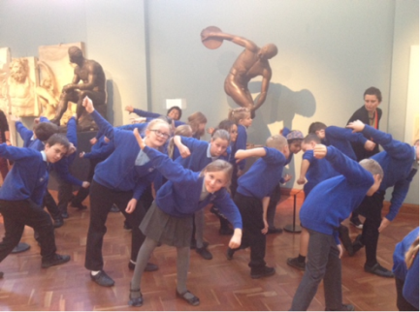
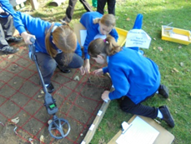
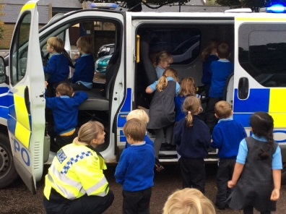
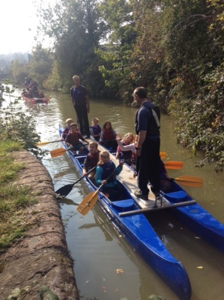
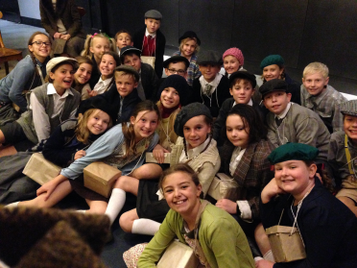
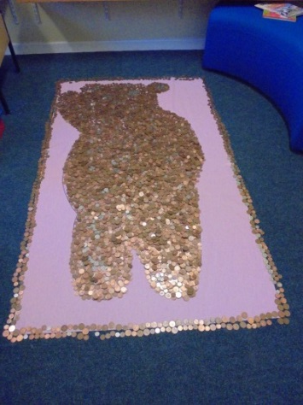
Just some of the events in Autumn Term
New
Year 4 did an Archaeology Investigation
Year 5 visited the As visited the Ashmolean Museum in Oxford.
To further their studies on Ancient Greeks,
Police visited Foundation Class
Year 6 spent the day as evacuees at Steam Museum
Year 5 and 6 took part in the Banbury Dragon boat races
E-Safety Workshops for parents and children in how to stay safe on the internet
For Remembrance day the Year 6 prefects joined the community at the War Memorial for the 2 minute silence.
For children in need the children filled Pudsey with small change.
We celebrated National Poetry Day this year by holding Poetry Workshops in each class. The children began by bringing their favourite poems into school to share with their classmates and then moved onto creating poems of their own, based around their class topic.
We raised money for the RAF Benevolent fund by wearing red, white and blue

Slide 10
Assessment
Parent evenings went very well with all parents receiving highlighted end of year objectives for their children.
New children’s record cards for all children have been issued which allows children to see which targets they have achieved and which ones they need to work on.
First pupil progress meetings have taken place and children who require early interventions have been identified.

Slide 11
Staff Development
Insets this term have focussed on:
RE, Maths, Gifted and Talented, Science, SEND, New Assessment procedures.
Training undertaken in Autumn
Whole school training on safeguarding and Prevent.
Induction for new staff
New RE leaders course
RE course for new teachers
E-Safety
Fire awareness course
Every Child a Writer intervention
NQT
Anti Bullying Training

Slide 12
Progress of school development plan
The Progress of Key Priorities within the School Development Plan- Leadership and Management
Objection/Action | On target | Partially on target | Off target | notes
Completion of whole school SEF | √
To challenge the MAC board to exercise its strategic view |  | √ |  | 1
To develop better leadership of learning and teaching | √
Enhance the role of middle leaders | √ |  |  | 2
Ensure performance management is challenging and fair | √ |  |  | 3
Enhance the school environment reflecting children’s ideas. | √ |  |  | 4
Learning walks with other MAC heads and subject leaders have taken place.
Numeracy and English Leaders reported to the board at this meeting.
3. PM objectives completed and recommendations for performance management have gone to pay committee and been agreed.
4. New junior Leadership team introduced to hear the children’s voice.

Slide 13
Self Evaluation- Leadership and Management
Descriptors | Outstanding | Good | Requires Improvement | Inadequate | Notes
Leaders and governors are committed to setting high expectations | √
Leaders and governors focus consistently on improving outcomes for all pupils | √
Leadership promotes equality of opportunity and diversity. |  | √
Pupils’ spiritual, moral, social and cultural development as well as British values are at the heart of the school | √
Safeguarding is effective including protecting pupils from radicalisation and extremism | √
There is effective deployment of Pupil Premium, SEND, Sports grant funding. | √

Slide 14
Self-Evaluation- Leadership and Management
Area | Grade
 | outstanding | Good | Requires improvement | Inadequate
Leadership and Management | √
Strengths
Robust yet supportive performance management system- teaching and its impact on learning is evaluated formally each term.
Development of middle leaders
Pupils’ attainment and achievement- monitored termly to ensure high standards are sustained and improved on.
The school’s development plan is focussed and identifies the school’s many strengths and provides a perceptive view of areas for further development.
Audits- This year’s annual H&S, and finance audits have been very good.
Staff well being survey was excellent
Governors’ Impact- Governors continue to closely monitor the school and challenge the Head
Strong engagement with families- through the newsletter, coffee mornings, parent questionnaires. Parents feel that their views are valued and used to improve the school further.
Pupil voice- New junior leadership team to meet senior leadership team fortnightly for a working lunch, discussing key priorities for the children and school.
Priorities for Improvement
Additional opportunities for families to feed into the school improvement cycle
Succession planning for SLT
To improve links with the parish once the new priest has arrived.

Slide 15
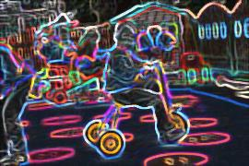
The Outcomes of pupils at the school

Slide 16
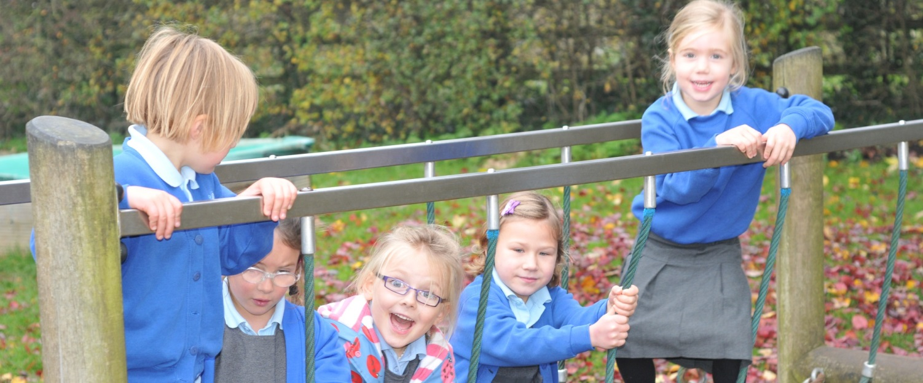
2015 Raiseonline Presentation
Aim:
To analyse data on attainment and progress, from ‘Raiseonline’, to enable governors, or those with a similar responsibility, to hold senior leaders to account.

Slide 17
PRIOR ATTAINMENT AT KS1
NC Year Starting | SCHOOL | NATIONAL | DIFFERENCE
Year 6 | 17.2 | 15.5 | 1.7
Year 5 | 17.3 | 15.8 | 1.5
Year 4 | 16.5 | 15.9 | 0.6
Year 3 | 17.6 | 16.1 | 1.5
ANALYSIS:
Prior attainment in APS from KS1 is above national for all KS2 year groups.
The current picture for our school is: most children enter reception at national
expectation and are above national expectations by Year 2 and well above by Year 6
Next Steps
Ensure that children continue to make at least expected progress with an increase in
children making better than expected progress.

Slide 18
Contextual Information
Characteristics of the school | School | National | Ofsted rating
Number on roll. | 196 | 269 | BA
% of pupils eligible for FSM | 8.5 | 26 | WBA
% of pupils supported with SEND | 12.5 | 13 | A
% of pupils supported with EHCP | 0.5 | 1.4 | BA
Stability | 85.9 | 85.9 | A
School deprivation indicator | 0.1 | 0.24 | BA
Key:
A- Average, AA- Above Average, WBA- Well Below Average, BA- Below Average
Analysis
The school is a one class intake
The % of Ever6FSM pupils is well below national average
The % of pupils with SEND is average
The school deprivation indicator is below average when compared to the national average. 10% of our pupils are living in families that are income deprived

Slide 19
Y1 Phonics Screening Check
 | Cohort | % School | % National
All pupils | 26 | 88 | 77
FSM | 0 |  | 66
Non FSM |  | 88 | 80
SEND | 1 | 0 | 42
Non SEND | 25 | 92 | 83
EAL | 1 | 100 | 76
Unclassified | 2 | 50 | 40
Non EAL |  | 91 | 77
Male | 14 | 93 | 73
Female | 9 | 82 | 81
% achieving 100% |  | 33 | 17
ANAYSIS:
School achieved well above national standards.
88% of children passed the check an increase of 11% on 2014
Next Steps
To maintain this high pass rate

Slide 20
Attainment at KS1
Subject | School v National | L2 | L2B | L2A | L3 | 2014 L3
Reading | school | 97 | 97 | 79 | 45 | 30
 | national | 90 | 82 | 59 | 32
Writing | school | 97 | 97 | 52 | 28 | 17
 | national | 88 | 72 | 41 | 18
Maths | school | 97 | 97 | 72 | 38 | 10
 | national | 93 | 82 | 55 | 26
ANALYSIS:
Attainment in all subjects was well above national figures.
% of children achieving level 3 had increased from previous year (SDP target)
NEXT STEPS:
To continue to be above national expectation.

Slide 21
Attainment of Groups at KS1
Characteristics | Reading |  | Writing |  | Maths
 | School APS | National APS | School APS | National APS | School APS | National APS
All pupils (29) | 18.2 | 16.6 | 16.9 | 15.3 | 17.8 | 16.4
FSM (4) | 16 | 15.2 | 15.5 | 14 | 17 | 15.2
Non FSM (25) | 18.5 | 17.1 | 17.2 | 15.8 | 17.9 | 16.8
EAL (0)
SEND (3inc 1 EHCP) | 13 | 12.8 | 13 | 11.6 | 13 | 13.2
White British (26) | 18.2 | 16.8 | 16.9 | 15.4 | 17.9 | 16.5
Other (2) | 19 | 17.1 | 18 | 15.8 | 16 | 16.8
Male | 18.2 | 16.1 | 16.9 | 14.6 | 18.3 | 16.4
Female | 18.1 | 17.2 | 17 | 16.1 | 16.8 | 16.5
ANAYLSIS:
All groups performed better than national figures in all subjects.
SEND pupils performed in line with their peers and if the child with the EHCP was not included performed well above national figures.
NEXT STEPS:
Increase the percentage of girls achieving a level 3 in maths. 90% of the pupils who achieved a level 3 in maths were boys.
Continue to narrow the gap of disadvantaged children .

Slide 22
Attainment at KS2
Subject | School v National | L4+ | L4B+ | L5 | L6
Reading | School | 100 | 93 | 71 | 4
 | National | 89 | 80 | 48 | 0
 | Difference | 11 | 13 | 23 | 3
 | Significance |  |  | Sig+
Writing | School | 100 | - | 50 | 0
 | National | 87 | - | 36 | 2
 | Difference | 13 |  | 14 | -2
 | Significance
Maths | School | 100 | 96 | 68 | 11
 | National | 87 | 77 | 41 | 9
 | Difference | 13 | 20 | 26 | 2
 | Significance |  | Sig+ | Sig+
SPaG | School | 89 | 86 | 68 | 7
 | National | 80 | 73 | 55 | 4
 | Difference | 9 | 13 | 12 | 3
 | Significance

Slide 23
ANALYSIS OF KS2 data
Attainment of 100% of children achieving a level 4 in all subjects and 46% achieving a level 5 in all subjects significantly above national figures.
APS in all subjects significantly above national figures.
APS for all subjects was 31.2 against national figure of 28.8
Achieved our first level 6 in reading.
% Attainment in SPaG at level 4 and 5 significantly up from previous year -13%
Next Steps:
Maintain current level of outcome for our pupils

Slide 24
Attainment of Groups at KS2
Characteristics | Maths |  | Reading |  | Writing
 | School APS | National APS | School APS | National APS | School APS | National APS
All Pupils | 31.7 | 29 | 31.5 | 29 | 30 | 28.2
FSM -1 | 39 | 27.3 | 33 | 27.6 | 27 | 26.6
Non FSM | 31.4 | 29.3 | 31.4 | 29.6 | 30.1 | 28.8
SEND | 30 | 25.1 | 28.5 | 25.4 | 28.5 | 24.3
Non SEND | 32 | 30.1 | 32 | 30 | 30.3 | 29.4
Prior attainment
Low | 30 | 23.5 | 27 | 23.7 | 27 | 22.4
Middle | 31 | 28.9 | 30.6 | 29.3 | 28.2 | 28.4
High | 33 | 33.6 | 33.6 | 32.4 | 33 | 32.4
Characteristics | Maths |  | Reading |  | Writing
 | School APS | National APS | School APS | National APS | School APS | National APS
All Pupils | 31.7 | 29 | 31.5 | 29 | 30 | 28.2
FSM -1 | 39 | 27.3 | 33 | 27.6 | 27 | 26.6
Non FSM | 31.4 | 29.3 | 31.4 | 29.6 | 30.1 | 28.8
SEND | 30 | 25.1 | 28.5 | 25.4 | 28.5 | 24.3
Non SEND | 32 | 30.1 | 32 | 30 | 30.3 | 29.4
Prior attainment
Low | 30 | 23.5 | 27 | 23.7 | 27 | 22.4
Middle | 31 | 28.9 | 30.6 | 29.3 | 28.2 | 28.4
High | 33 | 33.6 | 33.6 | 32.4 | 33 | 32.4
ANALYSIS:
KS2 attainment for SEND and disadvantaged children has narrowed.
Outcomes for all groups is better than national figures
Children who were identified as low attainter’s achieve significantly better APS scores than national figures.
Next Steps:
Narrow the gender gap in maths, boys had an average APS of 33 compared to girls who had 30.6

Slide 25
Progress Measures- Value Added (VA)
Characteristics | Maths |  | Reading |  | Writing
 | School VA | National VA | School VA | National VA | School VA | National VA
Boys | 100.9 | 100.5 | 100.4 | 99.9 | 99.9 | 99.7
Girls | 98.7 | 99.5 | 100.4 | 100 | 99.2 | 100.3
FSM -1 | 108.7 | 99.8 | 104.1 | 99.7 | 97.7 | 99.8
Non FSM | 99.4 | 100.1 | 100.3 | 100 | 99.6 | 100
SEND | 100.8 | 99.4 | 99.4 | 99.3 | 100.5 | 99.3
Non SEND | 99.6 | 100.1 | 100.6 | 100.1 | 99.4 | 100.1
Low | 101.9 | 100.2 | 100.7 | 100.1 | 102.1 | 100.2
Middle | 100.8 | 100 | 100.2 | 100 | 98.8 | 99.9
High | 97.9 | 99.8 | 100.7 | 99.8 | 100.2 | 99.9
Value Added (VA) is the difference between a child’s actual score (aps) and their predicted score aps
Analysis:
VA in 2015 in reading is significantly above national average.
Disadvantaged pupils, SEND and low attainers are significantly above national figures.
Due to a high APS in KS1, over 50% of cohort achieving a level 3 in reading, it was very hard for these children to achieve higher than their predicted APS which would be a level 6. Which 0% of the national figures achieving this.
NEXT STEPS:
Ensure high ability group in maths receive intensive boosting.

Slide 26
KS1 to 2 expected Progress
Characteristics | Maths |  | Reading |  | Writing
 | School % | National % | School % | National % | School % | National %
Boys | 100 | 90 | 100 | 90 | 100 | 93
Girls | 100 | 89 | 100 | 92 | 100 | 95
FSM -1 | 100 | 86 | 100 | 88 | 100 | 92
Non FSM | 100 | 91 | 100 | 92 | 100 | 95
SEND | 100 | 79 | 100 | 83 | 100 | 88
Non SEND | 100 | 93 | 100 | 94 | 100 | 97
Low | 100 | 76 | 100 | 80 | 100 | 87
Middle | 100 | 92 | 100 | 95 | 100 | 96
High | 100 | 93 | 100 | 92 | 100 | 96
ANALYSIS:
All children including specific groups made expected progress.

Slide 27
Self Evaluation- Outcomes for pupils
 | Outstanding | Good | Requires Improvement | Inadequate | Notes
The progress across the curriculum of disadvantaged pupils, SEND is improving towards that of other pupils. | √
From each starting point, the proportions of pupils making and exceeding expected progress in English and Maths are high national figures. | √ | √ |  |  | 1
The attainment of almost all groups of pupils is broadly in line with national averages | √
Pupils are exceptionally well prepared for the next stage of education | √
Throughout each year group and across the curriculum current pupils make substantial and sustained progress. |  | √ |  |  | 2
1. Year 6 cohort last year achieved significantly above national figures in KS1 results which meant that achieving better than expected progress was very difficult as children need to gain a level 6.
100% of children achieved expected progress in all subjects.
2. New assessment in place this year and only had one pupil progress meeting so difficult to assess progress within year. However, last year all year groups made good progress but this year there is a focus on improving progress in Lower Key Stage 2.

Slide 28
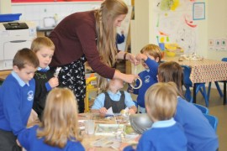
Early Years

Slide 29
2014-2015
 | Holy Trinity | Local Authority (2014 figures)
GLD | 83% | 60%
APS | 34.3 | 33.6
Average point scores (APS) shown here are for the EYFS profile only and do not equate to National Curriculum levels. The maximum possible point score for an incredibly able child would be 51. An average child might be expected to score 34 points.
A ‘good level of development’ (GLD) is deemed to be a child achieving EXPECTED in all prime areas plus Literacy and Mathematics.
Our EYFS exit score and GLD compare well to the LA and National figures (2014) .

Slide 30
2015-2016 Baseline data

Slide 31
Self Evaluation- Effectiveness of the Early Years
Descriptors | Outstanding | Good | Requires Improvement | Inadequate | Notes
Highly successful drive to improve outcomes and maintain the highest levels of outcome | √
Effective safeguarding | √
High engagement of parents |  | √ |  |  | 1
Children are motivated and eager to join in | √
Children make consistently high rates of progress | √ |  |  |  | 2
Assessment is accurate and based on high quality observations | √
Termly coffee morning for parents, teachers regularly asking parents for input, excellent attendance at parents’ evening
Excellent progress achieved last year and after Autumn’s PPM this year is looking very favourable, but it is only Autumn.

Slide 32
Personal development, behaviour and welfare

Slide 33
Attendance
September October
 | % Attendance | % of Lateness
Foundation | 96.53 | 0.57
Year 1 | 98.28 | 0
Year 2 | 96.18 | 0.10
Year 3 | 98.7 | 0
Year 4 | 95.08 | 0.08
Year 5 | 96.58 | 0.29
Year 6 | 97.74 | 1.38
 | Attendance | % of Lateness
Foundation | 96.92% | 0.36%
Year 1 | 97.55% | 0.05%
Year 2 | 97.23% | 0.42%
Year 3 | 96.84% | 0.04%
Year 4 | 95.37% | 0.21%
Year 5 | 95.03% | 0.22%
Year 6 | 96.16% | 1.33%

Slide 34
Behaviour Report
 | September | October
Level 2 incidents | 4 | 5
Level 3 incidents
There is one child who repeated breaks the behavioural policy and that child is in danger of having a fixed term exclusion. Professionals meeting was held on the 18th November with EP, Educational Officer and SENSS.
Racist and bullying incidents (from 1st September- 17.11.15)
Number of racist incidents | 0
Bullying incidents | 1

Slide 35
SEND at Holy Trinity
We have 28 children who are on the SEND register, we offer support in a variety of ways: Sept-Dec 2015
Support | Number of children
CAFs – Common Assessment Framework | 6 active, 1 closed and 1 not continuing with
TACs- Team around the Child | 2
SENSS- Special Educational Needs Support Services | 8 + 2 referrals
EP-Educational Psychologist | 3
Young Carers | 2
Assessing Witney hub | 4
PCAMHS | 5
CAMHS | 1
Social care referrals | 4
CHICKS- respite care | 6
Professional meeting | 1
Riding for the disabled | 2 possibly 3
Working with HSLW | 12
Speech and Language | 5
Official Wave 2 Interventions | 46 children
Working with a Quality First Teacher- QFT | 10
Gifted and Talented booster groups | 25

Slide 36
The Progress of Key Priorities within the School Development Plan- Personal development, behaviour and welfare
Objection/Action | On target | Partially on target | Off target | notes
Revisit the school’s behavioural policy | √
To continue to improve rates of attendance |  | √
To develop a whole school approach to internet safety | √ |  |  | 1
To monitor and develop pupils’ attitude to learning |  | √ |  | 2
To improve the process of monitoring serious incidents |  | √
E-Safety workshops for parents and all Key Stage 1 and 2 children have taken place in this Autumn term. New e-safety posters put up in all classrooms and new e-safety policy has been implemented.
New junior leadership team in place to help with pupil voice. Pupil questionnaire to go out in Spring term.

Slide 37
Self-evaluation- On the Effectiveness of Personal Development, Behaviour and Welfare
Descriptors | Outstanding | Good | Requires Improvement | Inadequate | Notes
Pupils are confident, self assured leaners | √
Pupils discussions and debates show respect for others’ ideas and points of view | √
Pupils value their education and attendance is good for all groups |  | √ |  |  | 1
Pupils’ impeccable conduct reflects the school’s strategies to promote high standards of behaviour |  | √ |  |  | 2
School works hard to prevent all forms of bullying | √
Pupils can explain accurately how to keep themselves healthy | √
Pupils’ spiritual, moral, social and cultural development equips them to be thoughtful, caring and active citizens in school and the wider community. | √
Pupils feel safe | √
We have had a number of requests from parents asking for holidays during term time. These have all been declined and if taken it has been an unauthorised absence.
Pupils behaviour is very good but we always feel there is room for improvement.

Slide 38
Effectiveness of teaching, learning and assessment

Slide 39
Quality of teaching, learning and assessment
Strengths
New assessment procedure where children know the targets they have achieved and what targets to work on.
New feedback and marking policy in place. Clearly setting out school’s expectations for teachers and pupils.
Lessons this term have all been at least good.
Early interventions are helping narrow the gap for less able pupils
Disadvantaged pupils are making good progress
Priorities for Spring 2016
Maintain outstanding teaching
Additional support for Lower Key Stage 2 classes
Continued support for Upper Key Stage 2 classes
Ensure targets are displayed in classrooms and in children’s books

Slide 40
Quality of Teaching 2014-2015 Lessons

Slide 41
Quality of Teaching
Learning environments
Quality of learning in books

Slide 42
Self evaluation on the quality of teaching, learning and assessment
Descriptors | Outstanding | Good | Requires Improvement | Inadequate | notes
Teachers demonstrate deep knowledge and understanding of the subjects they teach. | √
Teachers plan effective lessons maximising lesson time | √
Teachers check pupils understanding | √
Teachers’ feedback is in line with school policy and pupils know how to improve their work. |  | √
Pupils are eager to improve their learning and capitalise on opportunities to use feedback |  | √
Excellent cross curricular links | √
Parents are provided with clear and timely information on how well their child is progressing | √

Slide 43
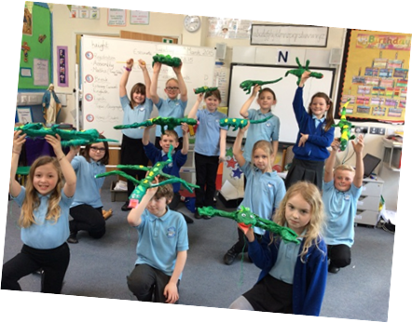
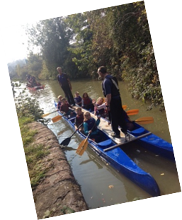
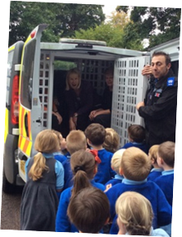
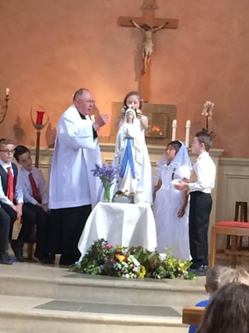
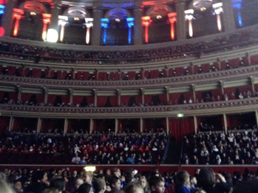
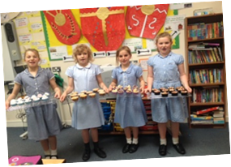
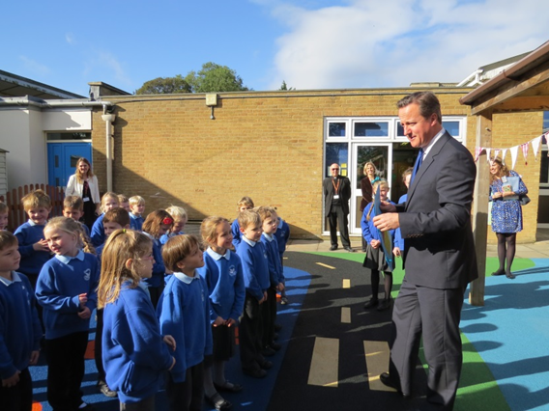
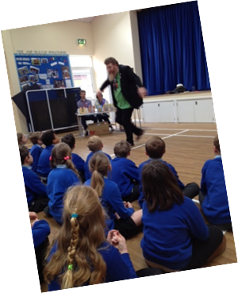
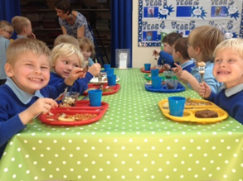
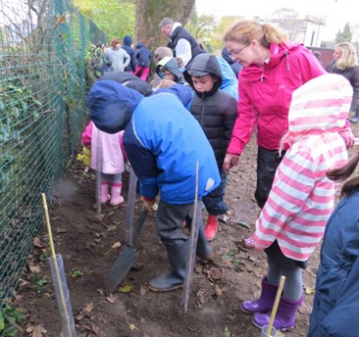
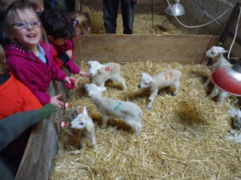
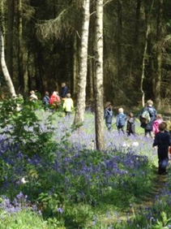
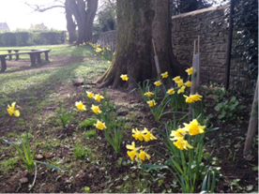
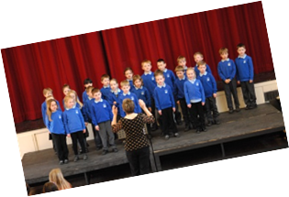
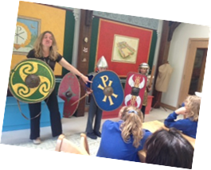
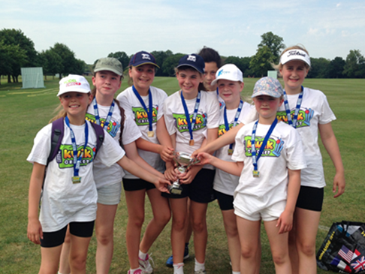
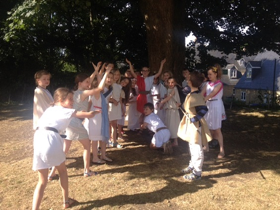
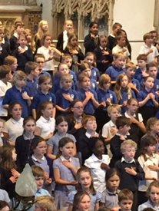
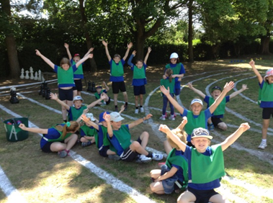
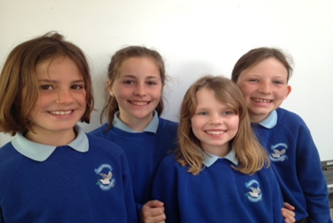
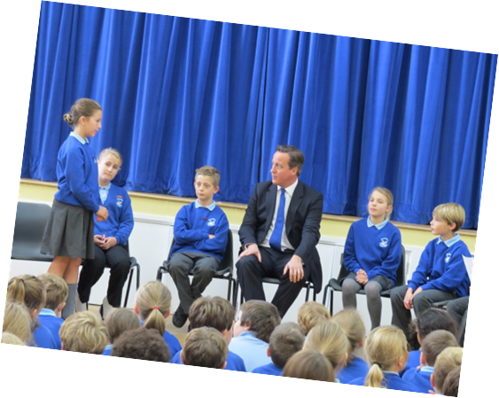
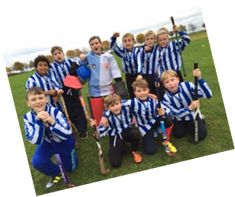
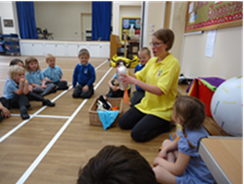
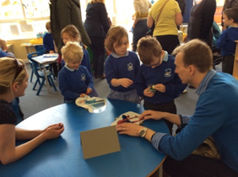
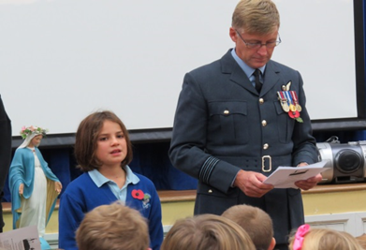
Our school
Mock election

Slide 44
Overall Effectiveness
Descriptors | Outstanding | Good | Requires Improvement | Inadequate
The Quality of teaching, learning and assessment | √
All other judgements are likely to be outstanding | √
The school’s thoughtful and wide-ranging promotion of pupils’ spiritual, moral, social and cultural development enables pupils to thrive | √
Safeguarding is effective | √

